Slide 1
The Bruning Government 1930-1932
The Dying Days of Weimar.

Slide 2
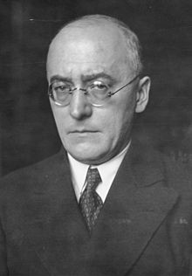
The government of Hermann Muller collapsed in March 1930 under pressure from all sides.
It was a weak minority government of coalition parties and was ineffective at passing legislation to deal with the economic crisis.
A new Chancellor was installed by President Hindenburg in Heinrich Bruning.
He was supported by the army and granted the use of Article 48 to pass legislation while bypassing the Reichstag.
His overall vision was to restore the monarchy and create a far more authoritarian state.
Democracy was roundly despised in all corners of German society.

Slide 3
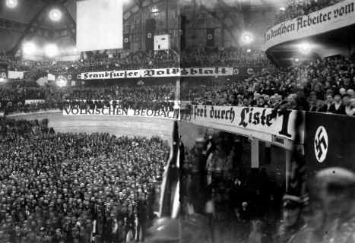
Many of Brunings hard line policies were at odds with the other major parties ideas.
His proposal to cut public service wages resulted in the Communists, Nazi’s, Socialists and Nationalists combining to call a no confidence motion in his leadership.
Bruning made a serious miscalculation at this point: He called an election for September 1930.
The Nazi Party launched a massive election campaign railing against the failures of the Republic – national humiliation, economic failure and political turmoil.
Hitler gave twenty major speeches to massive rallies in which he attacked the Weimar government and offered national liberation through unity and strength.

Slide 4
Hitler and the Nazi’s saw a massive swing in the vote towards their party and gained 95 seats in the Reichstag.
The result shocked the government, no one had realised the threat that this seemingly insignificant party had posed prior to this point.
Bruning managed to retain government and the chancellorship but the Nazi party was now central to German politics and Adolf Hitler was a national celebrity.

Slide 5
Bruning’s government struggled to deal with the economic situation that Germany found itself in.
The global depression made an already precarious German economy even more unstable.
Bruning issued decrees via Article 48 that reduced unemployment benefits and implemented a means test.
He attempted to stimulate the export market by slashing domestic prices.
This only served to spread the growing poverty into the business sector and make the economic situation even worse.
The crisis spread to the banking sector in mid 1931. Growing nervousness about the banks stability led to more and more Germans rushing to withdraw their savings. This cause a number of significant institutions to collapse.
Bruning was labelled the “hunger chancellor” due to his inability to effectively stop the downturn.

Slide 6
On the streets of Germany both the Nazis and the Communists frequently clashed, adding to the sense of chaos.
The first signs of the rift between Hitler and his SA began to show as he took a hard line on those within the organisation who still wanted an escalation of revolutionary violence.
The trouble with the SA culminated in a state police raid on their headquarters in Berlin. Documents indicating plans for a coup were discovered.
Bruning convinced President Hindenburg to issue a decree that dissolved the SA and SS.

Slide 7
Hitler ran as a candidate against Paul von Hindenburg in the 1932 Presidential elections.
This was largely a move to try and contain the power of Bruning who wanted Hindenburg to remain President as he could easily manipulate the aging war veteran.
Hitler knew that he would find it hard to defeat the popular Hindenburg in the ballot, and while he was defeated, the attempt further raised his public profile.

Slide 8
Hitler’s star was continuing to rise on the German political scene and the Bruning government’s continued failure meant that its days were numbered.
The political manoeuvrings of two politicians, Kurt von Schleicher and Franz von Papen, during 1932 would set the stage for Adolf Hitler and his party to rise to the zenith of German politics.

